Slide 1
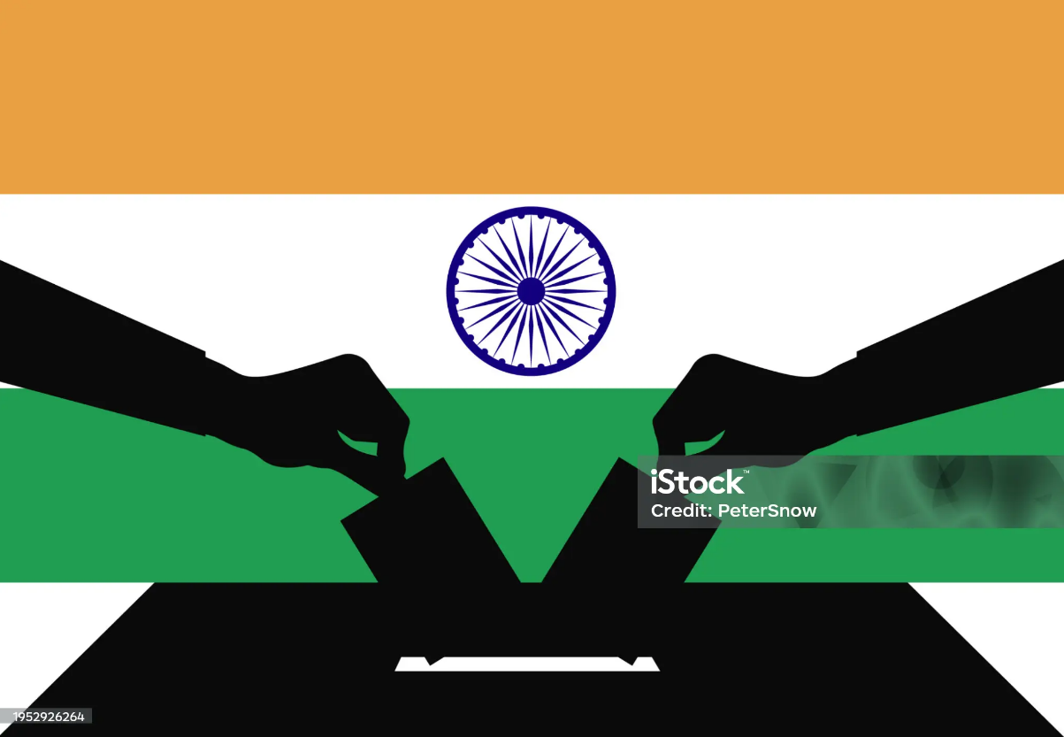
Election Analysis by using SQL

Slide 2

Project Description: This project involves analyzing election data to uncover insights related to voter behavior, turnout, and election results across different regions. Using SQL, the project aims to perform data cleaning, transformation, and querying to generate valuable insights from raw election data.
Objectives:
Analyze voter turnout across different states and constituencies in India, identifying trends over time.
Compare election results between various political parties, including winning margins and vote shares.
Identify key constituencies where voter turnout is significantly higher or lower compared to the national average.
Analyze demographic data (age, gender, literacy, etc.) to explore its impact on voter turnout.
Track party performance over multiple elections and examine shifts in political dominance.
Examine the relationship between rural vs. urban areas in terms of election outcomes and voter engagement.
Potential Outcomes:
1.A comprehensive report on voter turnout trends in India.
2.A detailed understanding of the shifting political landscape.
3.Insights into the relationship between demographics and election outcomes.
4.Constituency-level analysis of voter participation and political competition.

Slide 3

Entity Relationship Diagram (ERD) / Schema
Partywise_Results (pr)
Party
Won
Party ID
Party Allianz
Constituencywise_Results (cr)
Parliament Constituency
Constituency Name
Winning Candidate
Total Votes
Margin
Constituency ID
Party ID
Statewise_Results (sr)
Constituency
Const.No.
Parliament Constituency
Leading Candidate
Trailing Candidate
Margin
Status
State ID
State
Constituencywise_Details (cd)
Candidate
Party
EVM Votes
Postal Votes
Total Votes
% of Votes
Constituency ID
States (s)
State ID
State

Slide 4
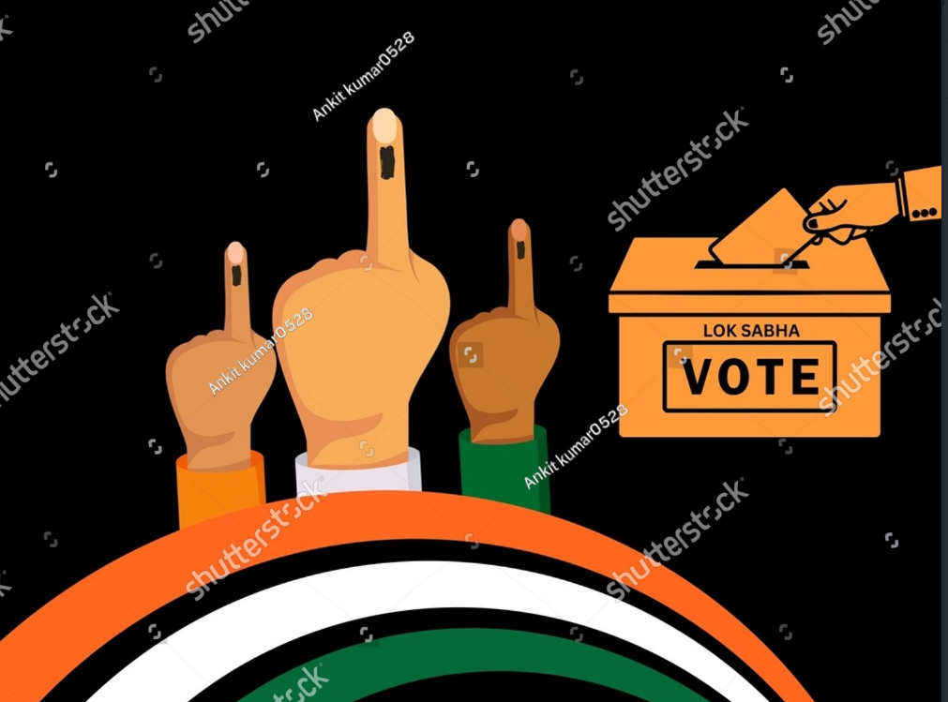
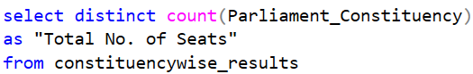
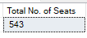
⇨ Compute the Total Seat Count?
The ballot is stronger than the bullet
⇨ Abraham Lincoln

Slide 5

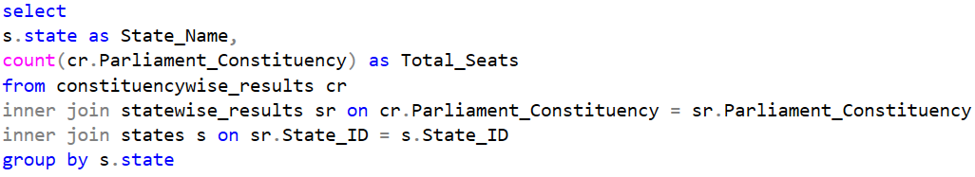
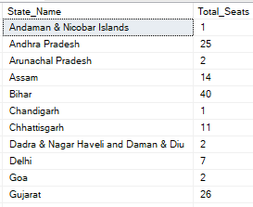
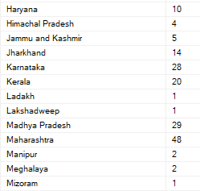
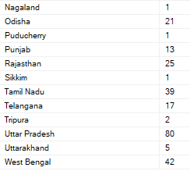
⇨ Summarize the total number of electoral seats distributed across each state ?
Bad officials are elected by good citizens who don’t vote
⇨ George Jean Nathan

Slide 6

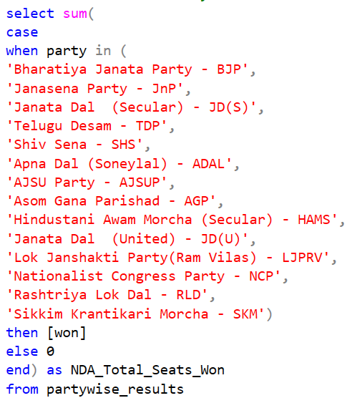
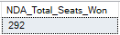
⇨ Determine the total seats claimed by the NDA alliance?
Voting is the expression of our commitment to ourselves, one another, this country, and this world ⇨ Sharon Salzberg
Note: Before calculating the seats of NDA alliance, initially we have to know that how many & which parties are there in NDA alliance.

Slide 7

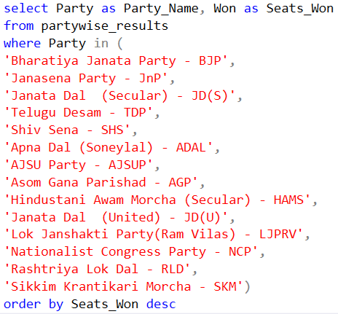
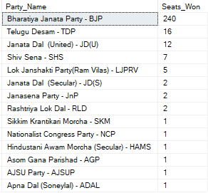
⇨ Determine the total seats claimed by the NDA alliance Parties?
The right to vote is a consequence, not a primary cause, of a free social condition ⇨ Benjamin Disraeli
Note: Before calculating the seats of NDA alliance Parties, initially we have to know that how many & which parties are there in NDA alliance.

Slide 8
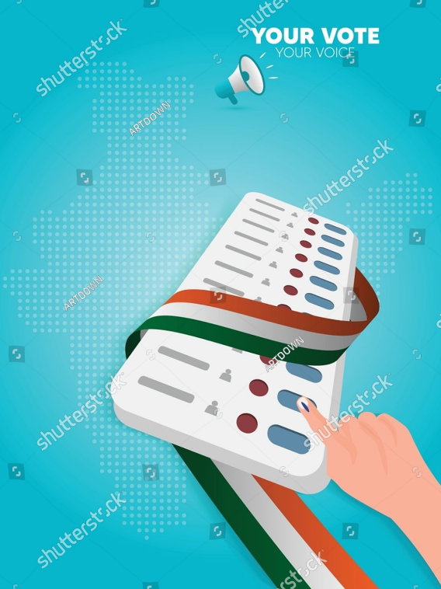
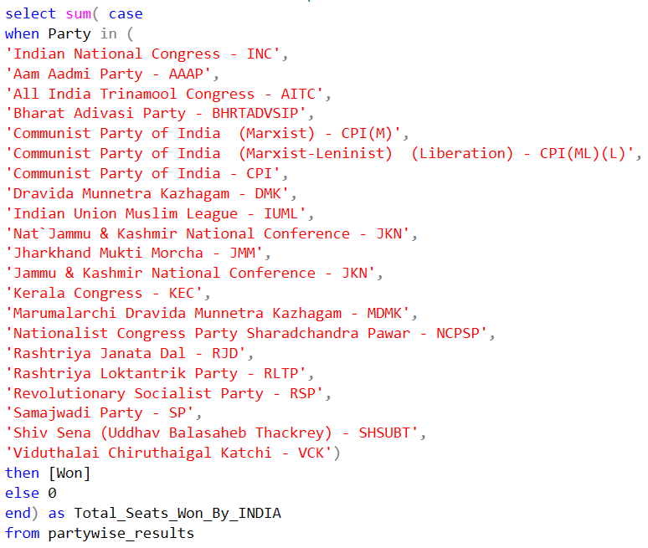
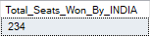
⇨ Determine the total no of Seats Won by I.N.D.I.A. Alliance?
A vote is a kind of prayer about the kind of world we want to live in ⇨ Rev. Dr. William J. Barber
Note: Before calculating the seats of INDIA alliance, initially we have to know that how many & which parties are there in INDIA alliance.

Slide 9
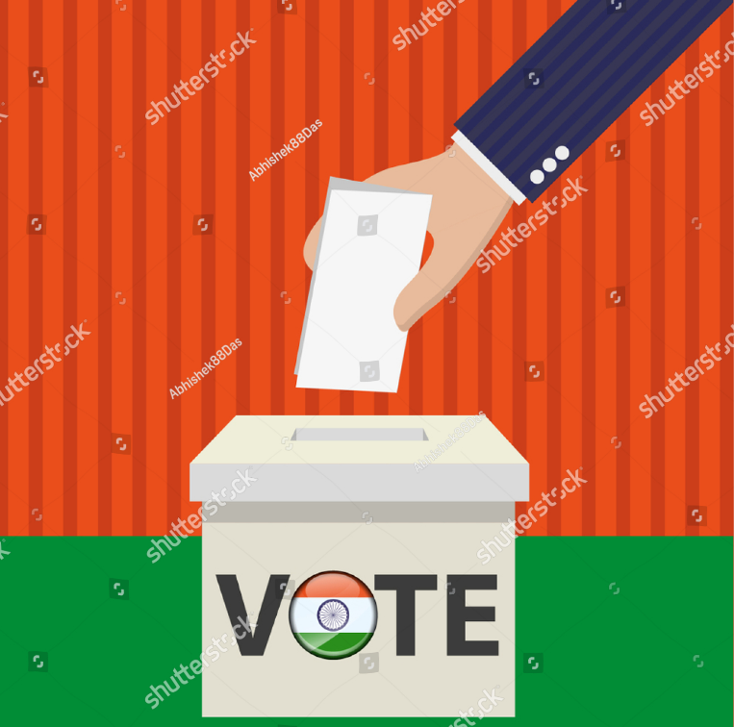
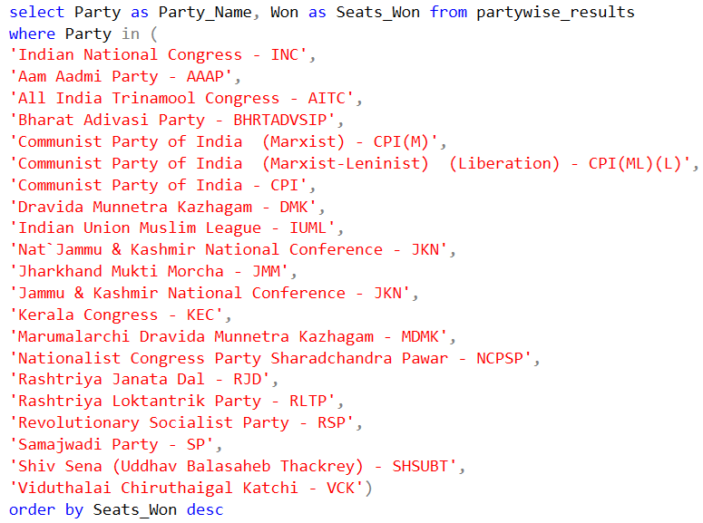
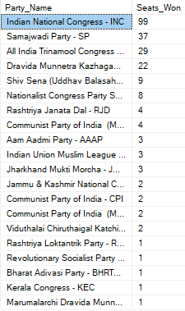
⇨ Determine the total seats claimed by the I.N.D.I.A. alliance Parties?
Your vote is your voice, and your voice is your power ⇨ Kamala Harris
Note: Before calculating the seats of INDIA alliance Parties, initially we have to know that how & which parties are there in INDIA alliance.

Slide 10

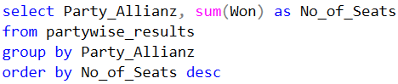
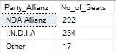
⇨ Which party alliance (NDA, I.N.D.I.A, or OTHER) won the most seats across all states?
Democracy is not just the right to vote, it is the right to live in dignity ⇨ Naomi Klein

Slide 11

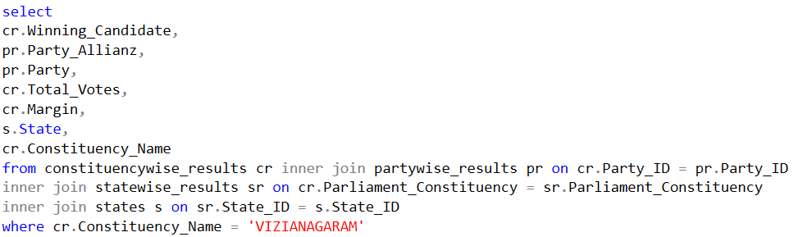
⇨ Find out the winning candidate's name, their party name, total votes, Party Alliance and the margin of victory for a specific state and constituency?
Voting is the foundational act that breathes life into the principle of the consent of the governed ⇨ DeForest Soaries

Slide 12
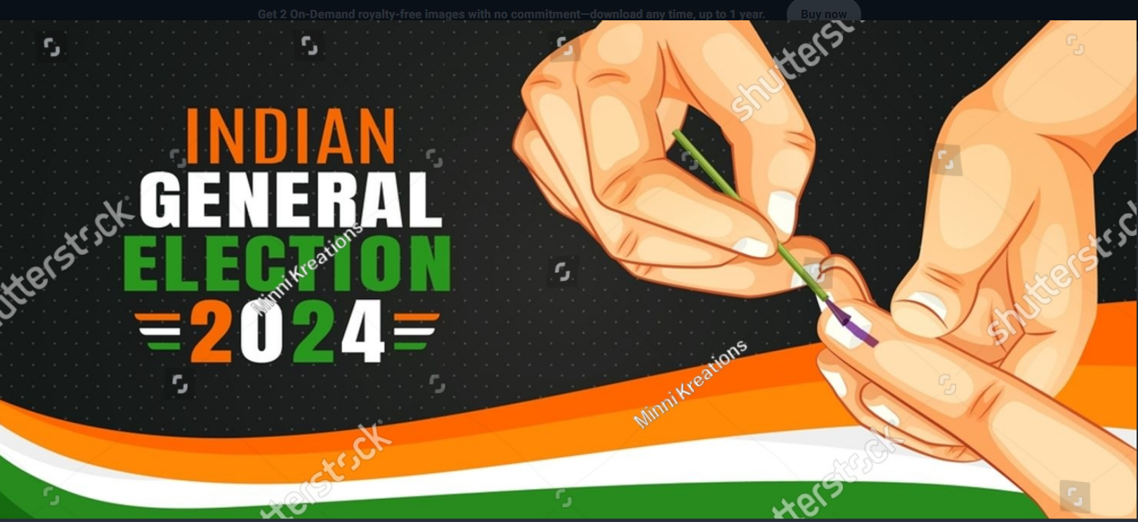
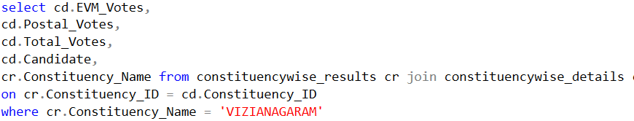
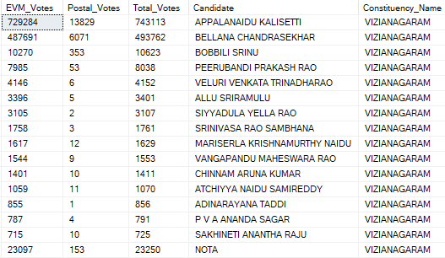
⇨ What is the distribution of EVM votes versus postal votes for candidates in a specific constituency?
Someone struggled for your right to vote. Use it
⇨ Susan B. Anthony

Slide 13

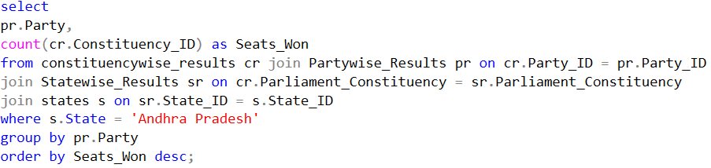
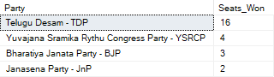
⇨ Which parties won the most seats in Andhra Pradesh State, and how many seats did each party win?
The vote is the most powerful nonviolent tool we have ⇨ John Lewis

Slide 14

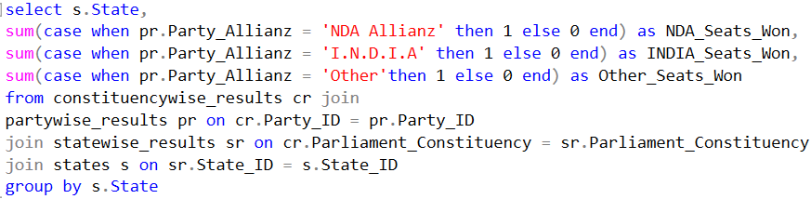
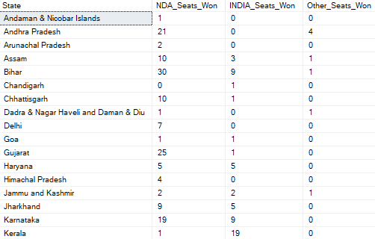
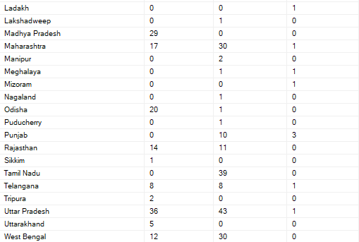
⇨ Calculate the total number of seats won by each party alliance (NDA, I.N.D.I.A, and OTHER) in each state for the India Elections 2024
A man without a vote is a man without protection ⇨ Lyndon B. Johnson

Slide 15
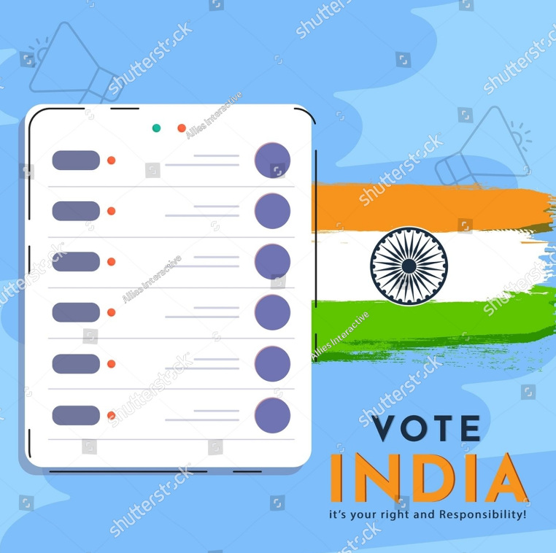
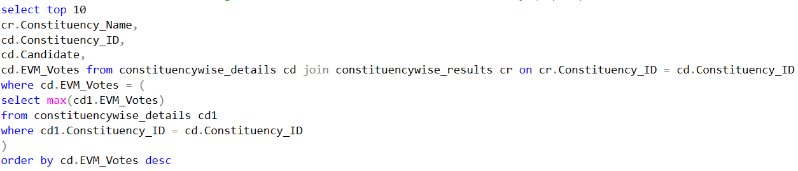
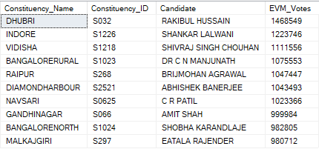
⇨ Which candidate received the highest number of EVM votes in each constituency (Top 10)?
A vote is the best way of getting the kind of country and kind of world you want ⇨ Alice Walker

Slide 16

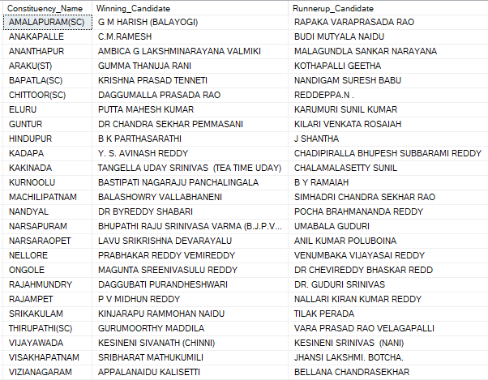
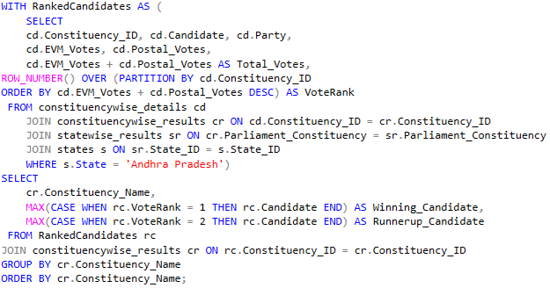
⇨ Which candidate won and which candidate was the runner-up in each constituency of specific State like Andhra Pradesh for the 2024 elections?
The ignorance of one voter in a democracy impairs the security of all ⇨ John F. Kennedy

Slide 17
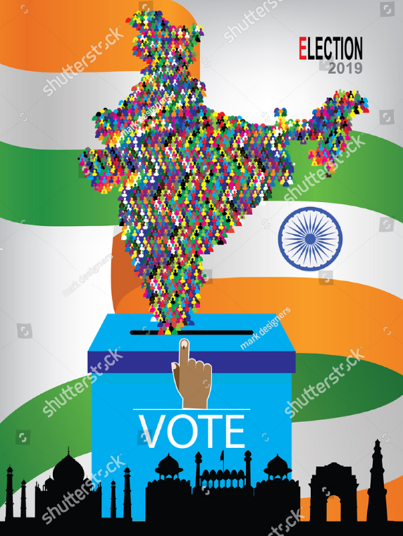
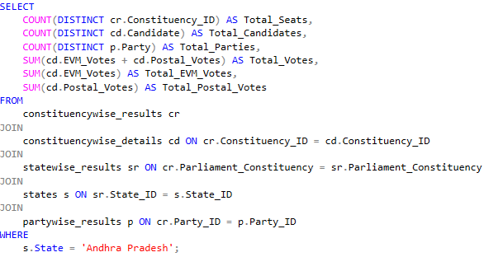
⇨ For the state of Andhra Pradesh or any state, what are the total number of seats, total number of candidates, total number
of parties, total votes (including EVM and postal),
and the breakdown of EVM and postal votes?
Democracy is not a spectator sport
⇨ Marian Wright Edelman

Slide 18

Thankyou Friends

